Slide 1

Simulation Analysis of the Temperature Dependence of Argon Structure and Dynamics
Jialin & Joe
5/4/2016

Slide 2
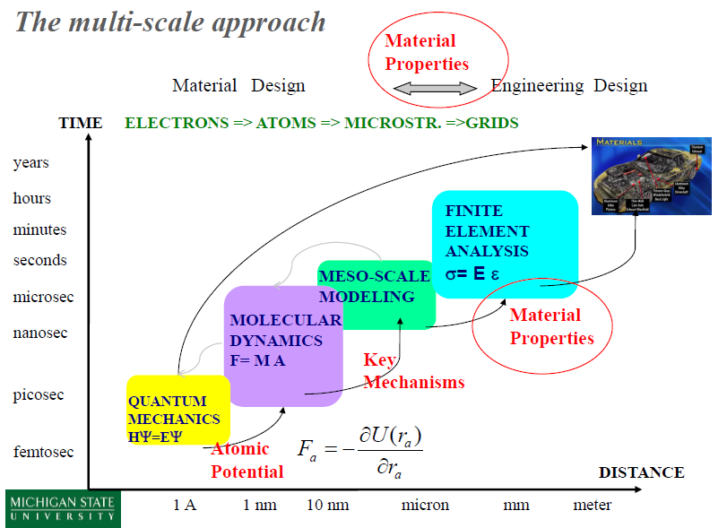
Background

Slide 3


Methods: Class
Class Atom
Create FCC structure
Add atoms
Assign Temperature
Print structure
Show 3D structure
Class MDSystem
Add structure
CheckPBC
PBC_distance
NVE
updateForce
updatePosition
verlet
Force
Dump
Log
SetDump
SetLog
updateVelocity
kineTicEnergy
Temperature
potentialEnergy
Momentum
DiffCoef
MDS

Slide 4
Methods: Main file
Main file:
myCell = Atom(1, [20, 20, 20], 39.948, 1, 5.405, 2)
myCell.assignTemperture(20)
s = MDSystem()
s.addStructure(myCell)
s.setDump('trajTest.xyz', 10, 3)
s.setLog('Ar_logTest.txt', 10, 1)
s.nve(0.001, 10)
nve:
def nve(self, timestep, simulationTime):
# do nve dynamic
self.timestep = cTime(timestep, 1)
self.simulationTime = cTime(simulationTime, 1)
while self.currentTime <= self.simulationTime:
self.verlet()
if (self.dumpMode != 0) & (np.mod(int(self.currentTime / self.timestep), self.dumpInterval) == 0):
self.dump()
if (self.LogMode != 0) & (np.mod(int(self.currentTime / self.timestep), self.LogInterval) == 0):
self.Log()
self.currentTime += self.timestep

Slide 5
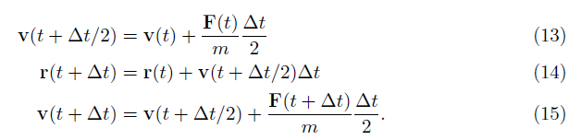
Methods: Verlet
Verlet:
def verlet(self):
# Do integral using verlet method
self.updataForce()
velocity2 = self.updataVelocity(self.structure.velocity, self.structure.force)
self.updataPosition(velocity2)
self.updataForce
self.structure.velocity = self.updataVelocity(velocity2, self.structure.force)

Slide 6
Methods: Unit conversion
Unit Conversion
Energy
Mass
Length
Temperature
Time
Force
Pressure
Velocity
DiffCoeff
def cEnergy(quant, mode):
# mode == 1: AU
# mode == 2: SI
# J -> AU
ratio = 1.651e-21
if mode == 1:
quant1 = quant/ratio
if mode == 2:
quant1 = quant*ratio
return quant1

Slide 7
Methods: PBC
Calculate distance under PBC:
def PBC_distance(self, x1, x2):
# Read cellLength from self.cellLength
cellLength = self.structure.cellLength
distance = x1 - x2
correctD = np.zeros((3))
for i in [0, 1, 2]:
correctD[i] = int(2 * (distance[i]) / cellLength[i]) * cellLength[i]
distance = correctD - distance
return distance
Check atoms PBC:
def checkPBC(self):
# Move atoms to current cell
cellLength = self.structure.cellLength
for i in xrange(0, self.structure.totNumberOfAtom, 1):
currentPosition = self.structure.position[i, :]
for j in [0, 1, 2]:
self.structure.position[i, j] -= math.floor(currentPosition[j] / cellLength[j]) * cellLength[j]

Slide 8
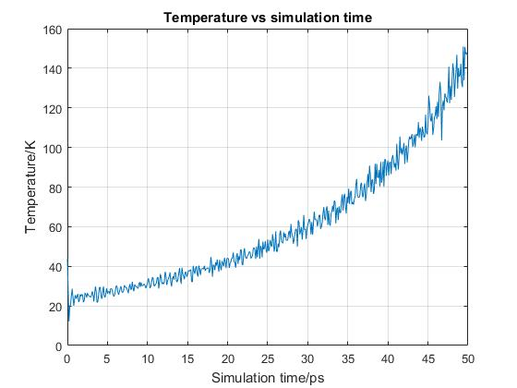
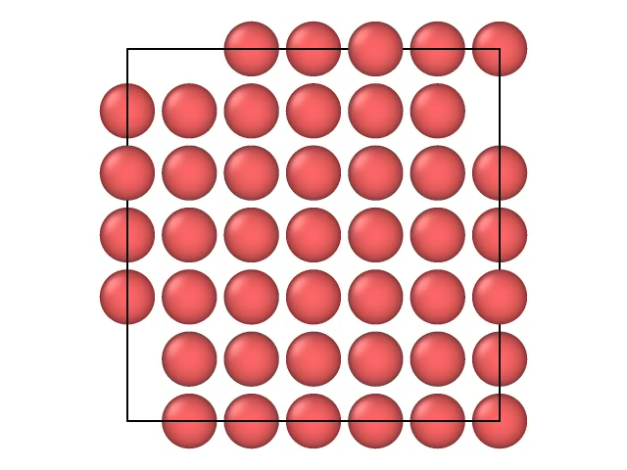
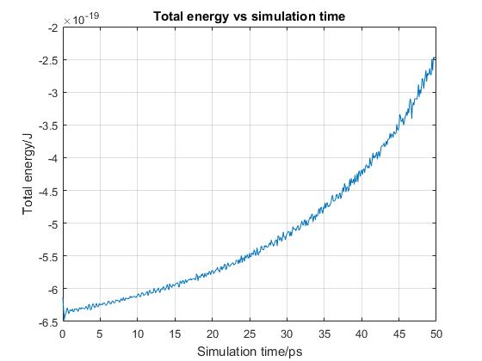
Results and discussion: Test run
Initial temperature = 50K
Cell parameter = 5.405 A
(Eq. bond length = 3.82A)
Simulation time = 50 ps
The trajectory shows extra momentum
Extra energy is introduced in somewhere

Slide 9
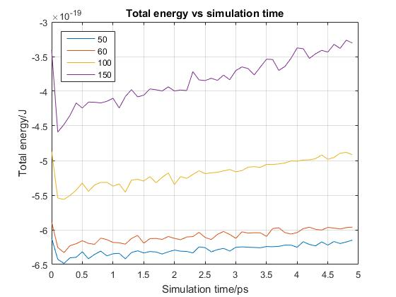
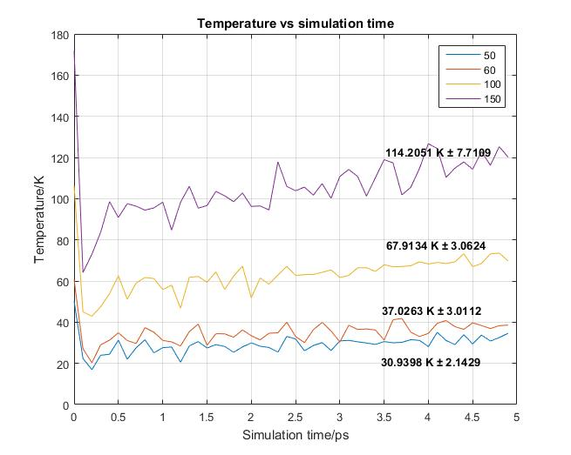
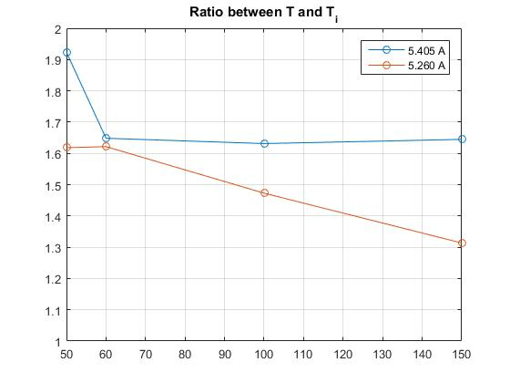
Results and discussion: short time, temperature ratio
Initially, the energy change is small (< 5 ps)
Assume 5 ps is enough for atomic relaxation
The ratio between initial temperature and final temperature is around 1.6

Slide 10
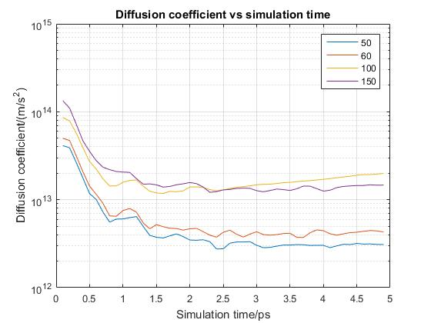
Results and discussion: melting temperature, cell length = 5.260 A
between initial T of 60K and 100K, the diffusion coefficient suddenly increased
The corresponding melting temperature is between 37K and 68 K

Slide 11
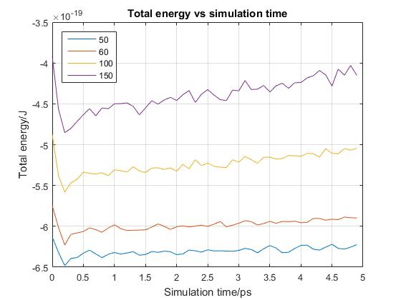
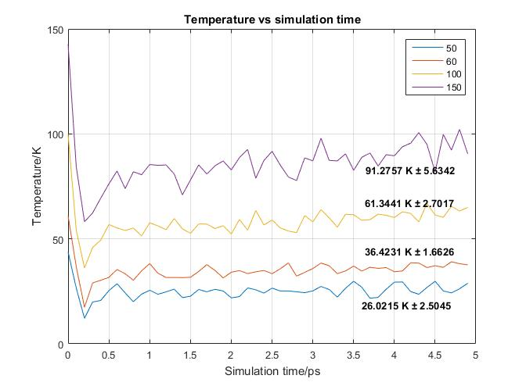
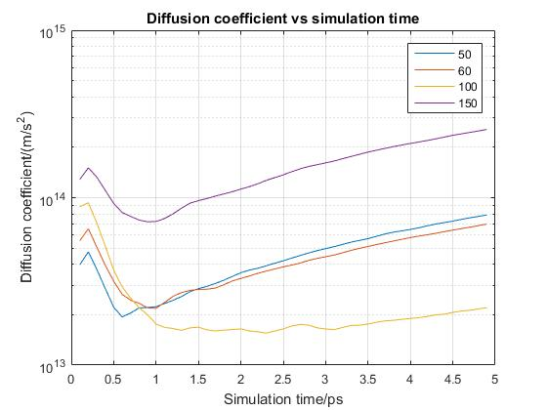
Results and discussion: melting temperature, cell length = 5.405 A
After expanding the crystal cell, the diffusion coefficient increased between 100K and 150K
The corresponding melting temperature is between 61K and 91K

Slide 12
Conclusion
MD code for NVE dynamic is build in python
Argon FCC lattice is build and run dynamics in NVE ensemble
The melting point of FCC is estimated based on diffusion coefficient

Slide 13

Thx

